Slide 1
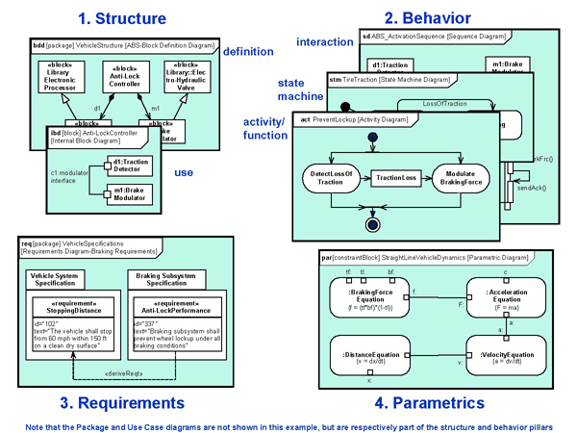
SE06 – System Architecture Modeling
Description
Tools to document architecture from system to software
Motivation (Score: 5.0)
Replace manual documentation with an automated system design tool
Better interface control
Deliverables
Tool selection & installation – SysML and UML
SysML definition
UML ?
Timing
Artisan Studio SysML software install completed Jan 2014
?
Team Members/Customers
Systems – Bill Wittig, Keith Marsh
Software – Keith Johnson
Customer – NA

Slide 2
SE06 – System Architecture Modeling
Status
Acquisition complete
Challenges
NA.
Next Steps
Expand user community
Awareness of tool and its usage
Hold additional formal training sessions

